Slide 1
A Traffic Light Scheduling System
——to reduce the waiting time of vehicles and pedestrians
Chenkai Shao, Suyang Hu, Siyuan Zheng
Department of Computer Science and Engineering
December 11, 2019

Slide 2
Goals
Minimizing average wait time of vehicles and pedestrians at a crossroad
Maximizing utilization of a crossroad
Ensure fairness as much as possible
Notes:
What problem in real life

Slide 3
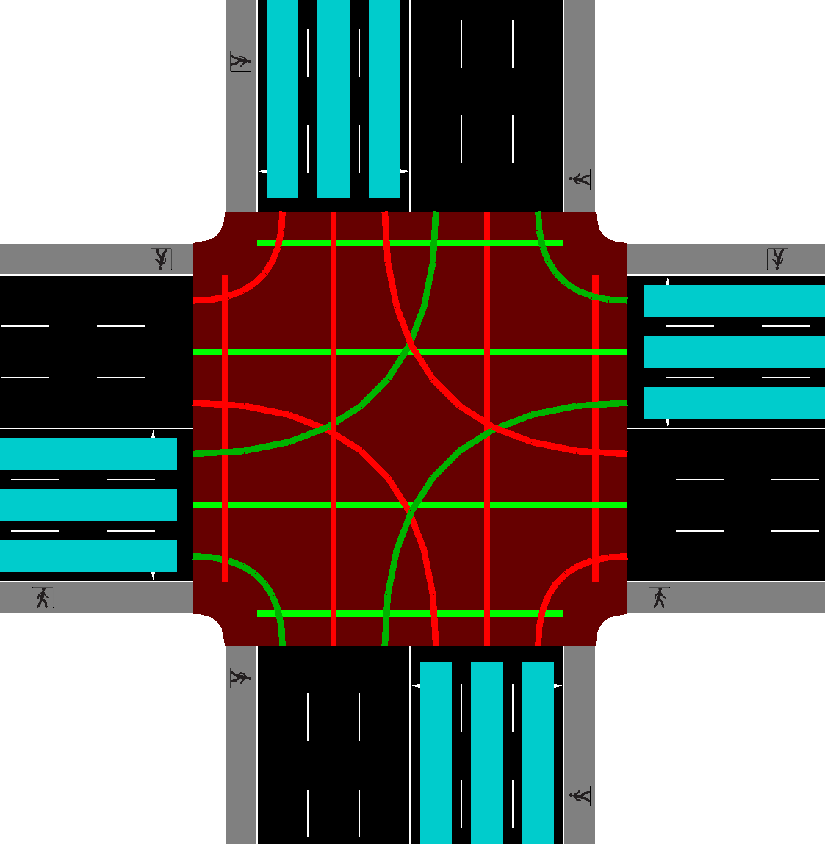
Model
Here we use a “standard” traffic lane. Vehicles may turn left, right or go straight in all four directions, and there exists 4 crossings for pedestrians. This means we have 16 traffic lights to consider when making schedules for one crossroad.
Notes:
This is a screenshot the crossroad model that we designed in our simulation tool.
ped crossing
16 lanes including pedestrian crossing

Slide 4
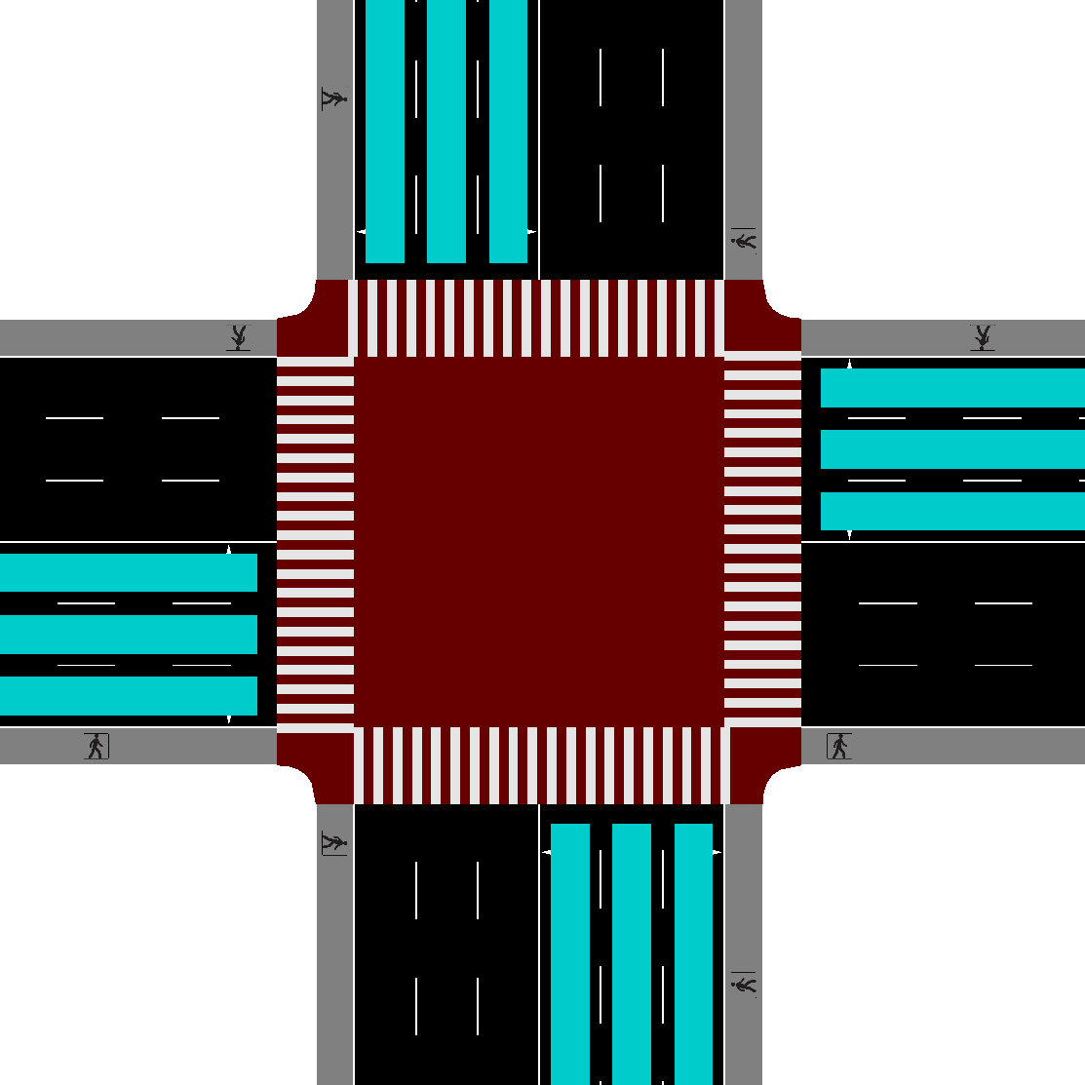
Model
We define mutually exclusive directions as those that do not intersect.
A group of mutually exclusive directions can allow traffic flow at the same time.
Sets of mutually exclusive directions depend on the configuration of crossroad.
Notes:
fixed period traffic light
fixed length of a phase
fixed states in a phase
a step further, break the two fixed concept
Exploit the concept of mutual exclusiveness
as many lanes as possible at the same time

Slide 5
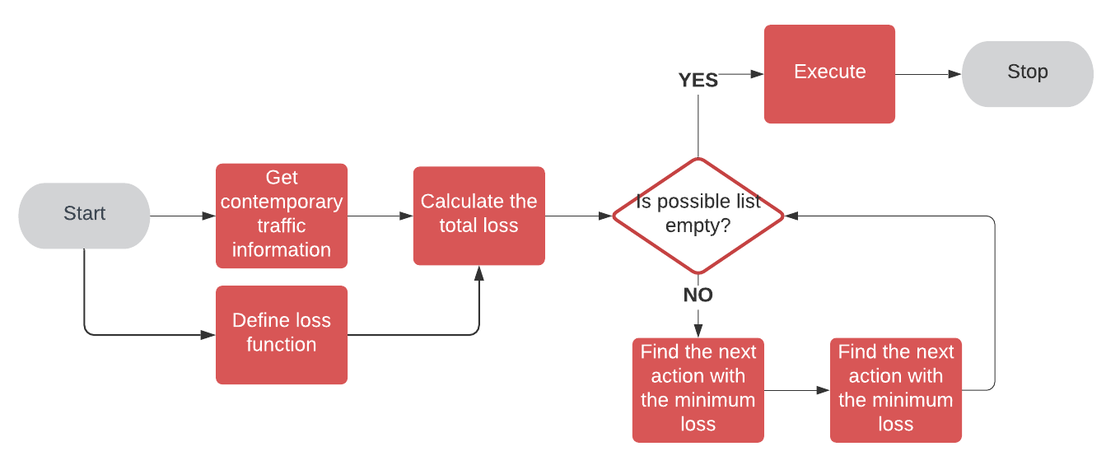
Algorithm
The algorithm structure is shown in the graph.

Slide 6
Algorithm
Our algorithm maintains a mutually exclusive matrix for all the traffic lights, so as to reduce the computing time when deciding the state of next traffic light.

Slide 7
Algorithm
Use the minimum cost loss to make schedule. We calculate the total number of pedestrians and vehicles waiting in each mutually exclusive traffic direction of the current one, and assign a penalty value based on this number.

Slide 8
Algorithm
Choose to schedule the traffic light with minimum loss at the beginning of each time period, and then go further to choose the next one with the minimum loss that is not mutually exclusive with the current one. Iterate this step until all the remaining lights are mutually exclusive.

Slide 9
Algorithm
Define a scheduling priority attenuation to deal with the situation in which two traffic lights have the same cost loss. Schedule the one with higher priority under this circumstance.

Slide 10

Simulation Environment
We use the SUMO platform to conduct simulation for our algorithm, in which information of roads, pedestrians, vehicles and traffic lights are configured. Python scripts can be used to obtain and control simulation status interactively. By implementing out proposed scheduling algorithm in the python scripts, we can decide the state of every traffic light at each time instant.
Notes:
open source
a lot of features and options

Slide 11
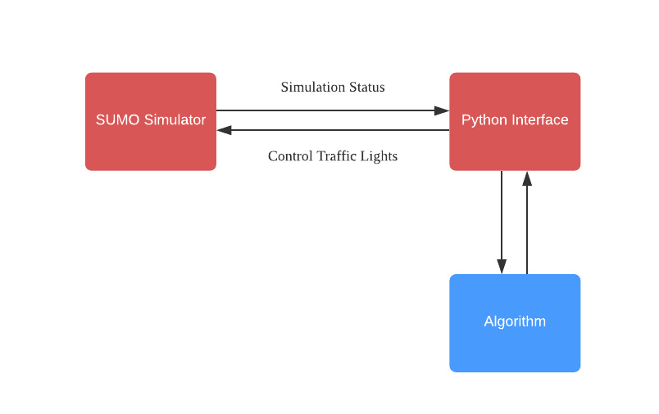
Simulation Environment

Slide 12
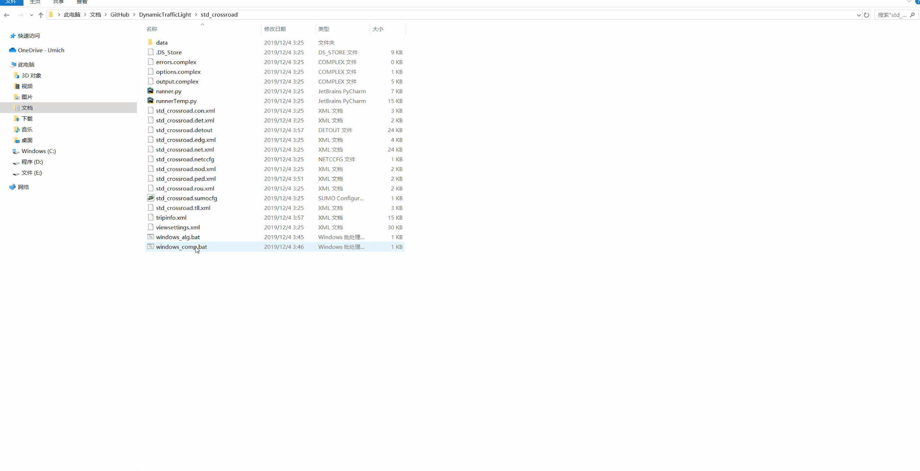
Simulation of Fixed Period Traffic Light

Slide 13
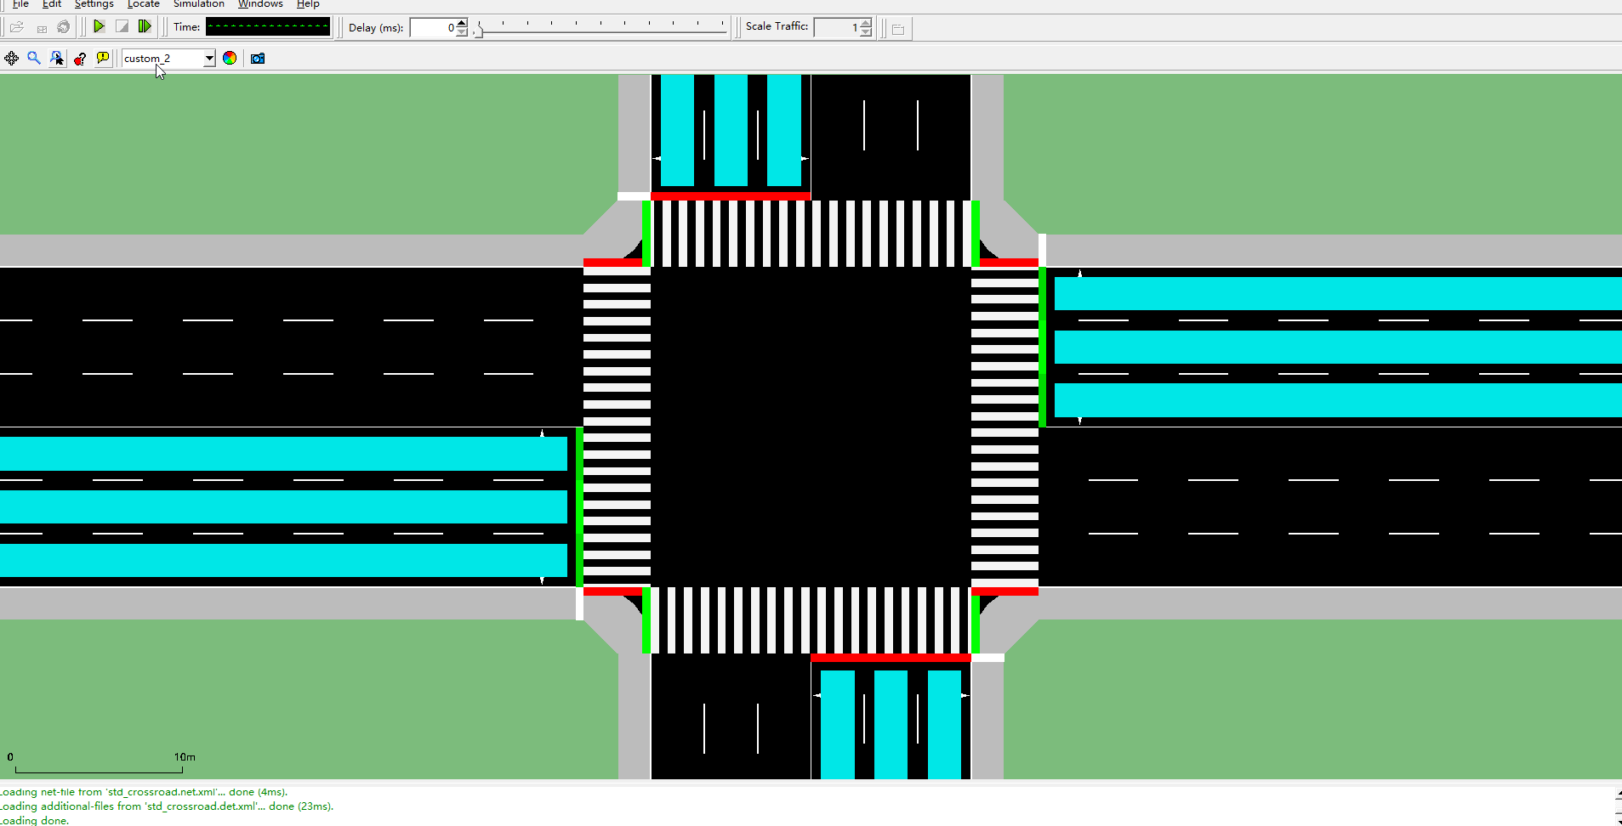
Simulation of Our Traffic Light Scheduling Algorithm
Notes:
Explain the difference between this simulation and that from last time

Slide 14
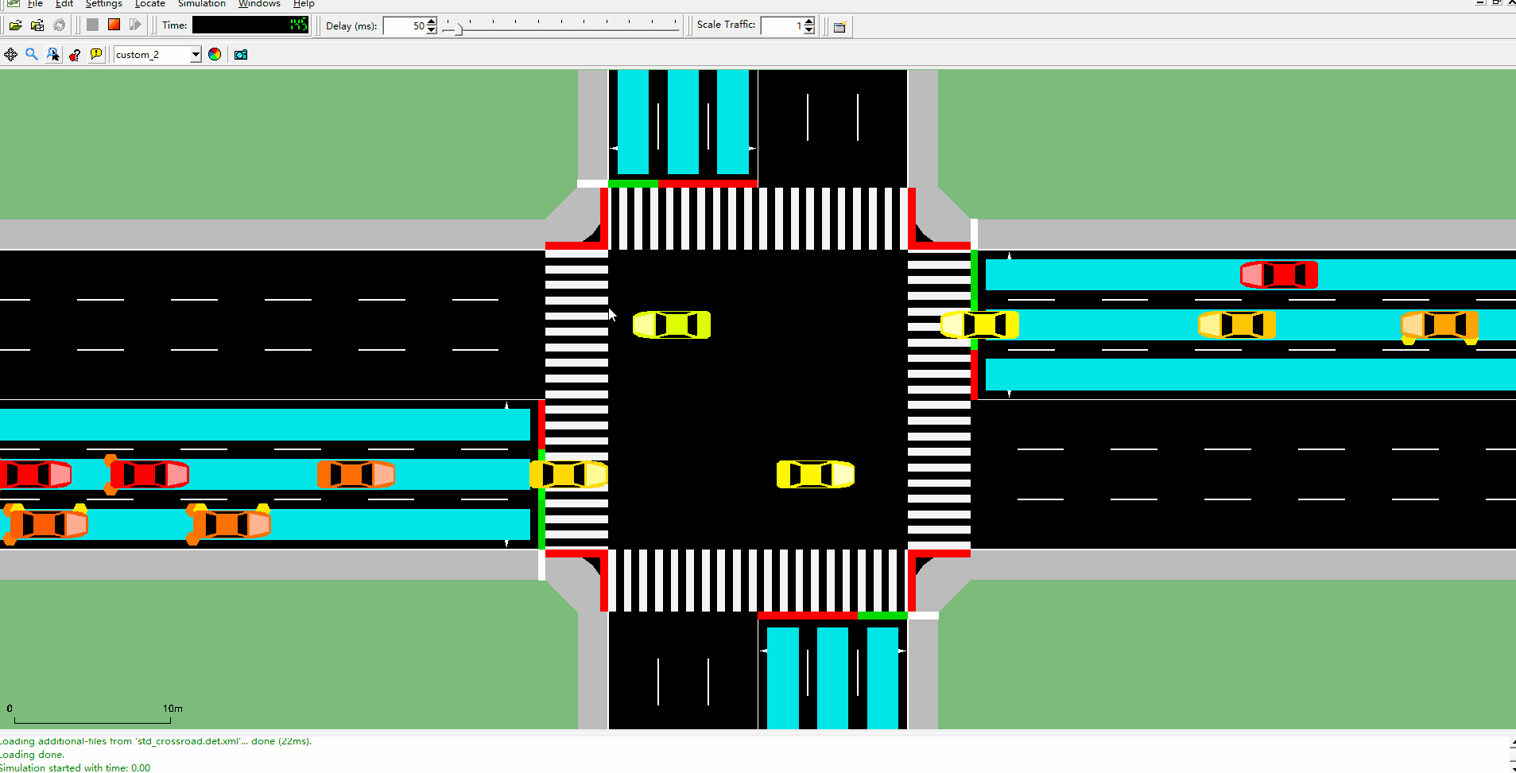
Fairness
The time loss (time lost in low speed, not necessarily completely stopped) of the infrequent vehicles in north and south are fairly low.
5.54 sec
3.91 sec
6.47 sec
2.82 sec
4.89 sec
Not blocked at all

Slide 15
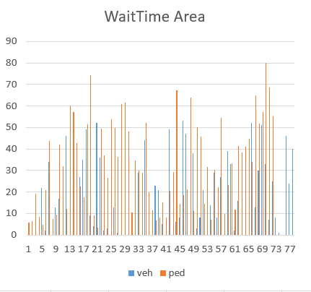
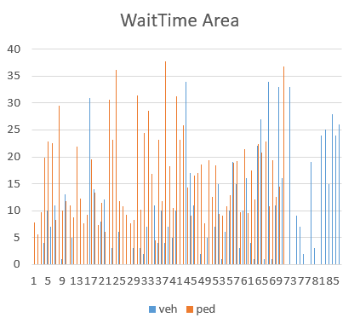
Fairness
Our Algorithm
Fixed Period Traffic Light
Notes:
Histogram

Slide 16
Fairness: How
Non-linear increase of penalty over time
Penalty(i + 1) = Penalty(i) * (Penalty(i) + 1)
Clear penalty when no car is halted
Set penalty to a low level when executed

Slide 17
Experiment Design:
We conducted the following comparative experiments to evaluate our proposed scheduling algorithm.
1. Compare the total waiting time of pedestrians and vehicles with different arriving rate between our algorithm and the default one.
2. Compare the schedule performance of two algorithms with different pedestrians and vehicles ratio.
3. Compare the schedule performance of our algorithm with different scheduling length to evaluate its stability.
4. Comparing the schedule performance of our algorithm with different object densities.

Slide 18
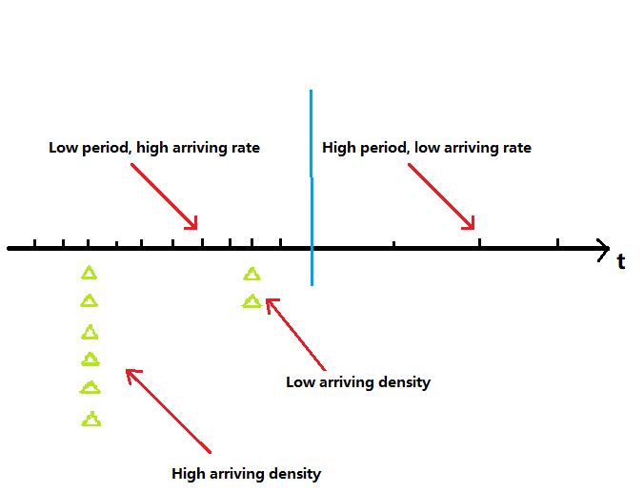
Experiment Design:
Scheduling time length

Slide 19
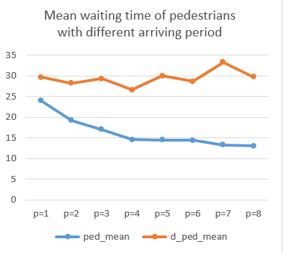
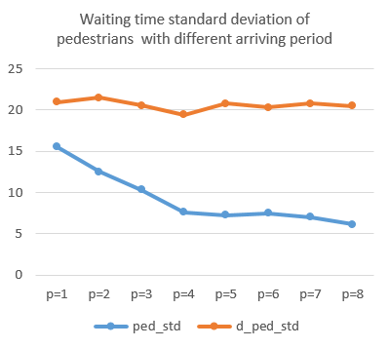
Experiment Evaluation:
With the decreasing of the inter-arriving period of vehicles and pedestrians, the average waiting time of our algorithm reduce significantly than the original default one.

Slide 20
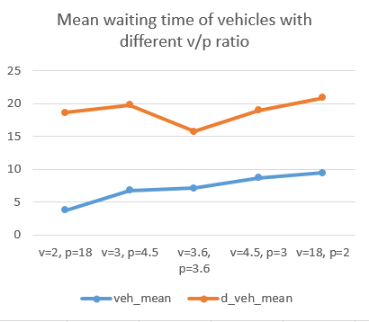
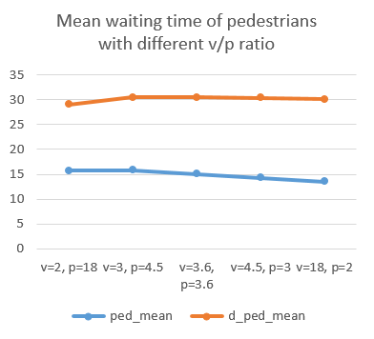
Experiment Evaluation:
Here we set the scheduling time as 180s, and the total number of vehicles and pedestrians as 200. Through adjusting different vehicle and pedestrian ratios, we prove the efficiency of our algorithm in various situation configuration. The average waiting time of all ratios are lower than those of default algorithm.

Slide 21
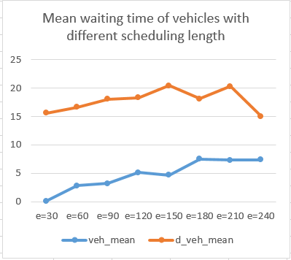
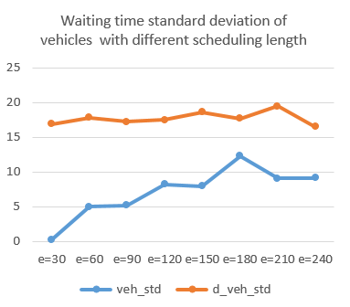
Experiment Evaluation:
In our algorithm, the mean and standard derivation of the vehicles’ waiting time increase a little with the increasing of the total scheduling time, but are still significantly lower than those of the random scheduling algorithm. This shows the stability of our algorithm.
Notes:
Mention that standard deviation is also reduced, showing fairness!!!

Slide 22
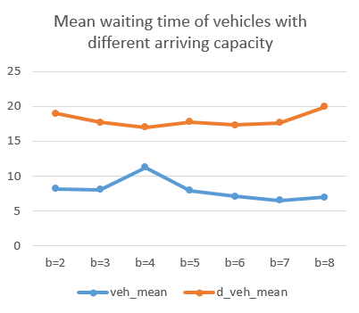
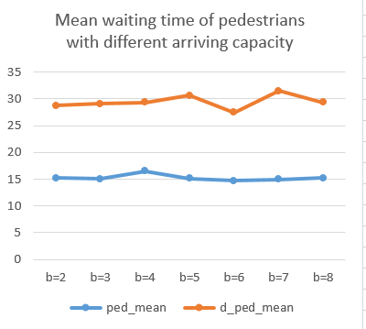
Experiment Evaluation:
Here we evaluate the performance of our algorithm with different object densities, which represents the maximum number of objects that could arrive at each time instant. The results show that it can deal with various arriving densities efficiently.

Slide 23
Team Works:
Each of us was involved in the process of the experiment and did his or her part.
Chenkai Shao:
Build a simulation environment.
Establish an intersection, traffic lights pedestrians and vehicles with Sumo and Traci
Siyuan Zheng:
Design scheduling algorithm.
Implement the algorithm with python which applies to the simulation.
Suyang Hu:
Integrate the simulation and the algorithm. Design and conduct comparative experiments and analyze the results.
Responsible for proposals and slides

Slide 24
Thank You!

